Slide 1

Battle of the Indicators
Financial performance of three major trading indicators across three major US stock assets
Mathias & Padraic

Slide 2

OBJECTIVE, TARGET & RATIONALE
Objective
To test which trading indicator would achieve superior financial performance through generating buy and sell signals (classical interpretation).
Target
A fund seeking to implement a technical/quantiative based approach to trading
Rationale
Many technical and quantitative traders use these indicators we are testing to generate buy and sell signals in discretionary or automated trading strategies. Its important for fund managers and traders to analyze historical performance of a particular strategy

Slide 3

ASSUMPTIONS & LIMITATIONS
Time series is fragmented due to the weekly API Data from both the asset and indicator (indicator data relative to asset data)
Due to indicator characteristics some indicators gave numerous signals and some gave very few
Due to time constraints only three assets were able to be tested meaning relatively low level of diversification
Each asset has unique price action and characteristics meaning a purely indicator based strategy is inherently limited as indicators are mathematically rigid

Slide 4

The Process
API time series data was taken for all assets and indicators from https://www.alphavantage.co/
The Json data was extracted into Jupyter notebooks and converted and transformed into combined data frames
A loop was constructed with the combined stock and indicator data to test the profitability over the available time series. This process was repeated 9 times, 3 indicators for each stock
Data was then loaded into a SQL data base A flask app was then constructed to serve as an endpoint
Basic table visualisations were built on using HTML and JS

Slide 5

What is a TRADING Indicator?
Trading indicators are mathematical calculations that are typically visualised and plotted on or under a price chart. These indicators can help traders identify when to buy and sell an asset
All calculations and visualisations are based on an assets price over a given time series
Trading indicators are either (generally) lagging or leading price. Leading indicators attempt to make predications about what price will do next whilst lagging indicators describe the current state of price and are slow to adjust to trend changes
Both types have pros and cons

Slide 6

The Indicators
Relative Strength Index (RSI)
Moving Average Convergence Divergence (MACD)
Stochastic Oscillator
All Indicators tested are Oscillators meaning they move between a set value or a range of values
A CLASSICAL INTERPRATION WAS TAKEN REGARDING HOW BUY AND SELL SIGNALS WERE GENERATED FROM EACH INDICATOR
There are different ways to interpret indicator signals classical refers to the most common approach taken by most traders

Slide 7
The ASSETS
APPLE (AAPL)
GOOGLE (GOOG)
TESLA (TSLA)

Slide 8

TIME SERIES ANALYSED FOR EACH INDICATOR & STOCK
APPLE
MACD: Sept 2000 – Oct 2021
RSI: Oct 2000 – Jun 2020
STOCH: Jun 2000 – Sept 2021
GOOGLE
MACD: Feb 2015 – Sept 2021
RSI: Feb 2020 – Sept 2020 (only two signals generated)
STOCH: Jun 2014 – Oct 2021
TESLA
MACD: Feb 2011 – Aug 2021
RSI: Feb 2016 – Nov 2019
STOCH: 2010 Sept – 2021 Jun

Slide 9
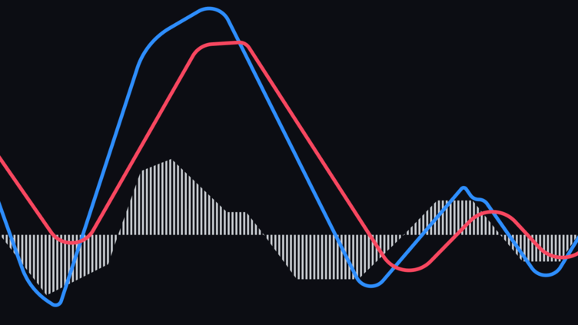
MACD VISUALISED
Equation:
MACD line = 12d EMA – 26d EMA
Signal Line = 9d EMA of MACD Line
MACD Histogram = MACD line – Signal Line

Slide 10
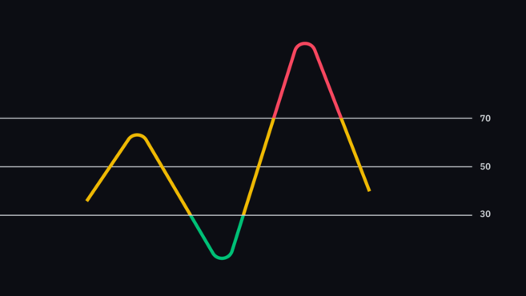
RSI VISUALISED
Equation:
RS = avg of 14 periods closing up / avg of 14 periods closing down
RSI = 100 – [100/ 1 + RS]

Slide 11
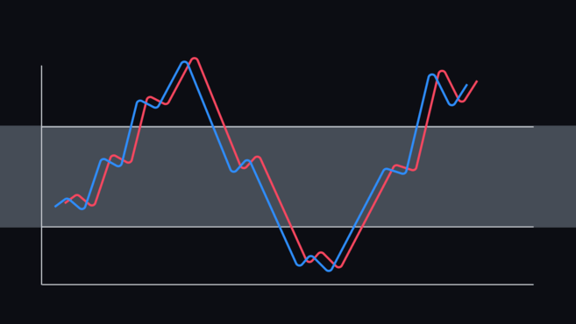
Stochastic OSCLIATOR
Equation:
n = designated number of time periods
(current close – lowest price(n) / highest price (n) – n) * 100

Slide 12
TOP Performing indicators
Results * ($10,000 initial investment) Assumes total capital is used to buy all shares and total shares are sold to redeem capital at each time interval
APPLE
MACD = $7,477
RSI = $36,306
STOCHASTIC = $3,868
GOOGLE
MACD = $26,677
RSI = $14,837
STOCHASTIC = $21,912
TESLA
MACD = $35,438
RSI = $17,531
STOCHASTIC = $91, 802

Slide 13

CONCLUSION
It cannot be concluded which indicator alone is superior
Financial markets are complex and trading based on mathematically rigid indicators will generally not be enough to achieve consistent alpha (extract risk adjusted profit from the market)
An interesting finding was that the indicator that “won” each asset well outperformed the remaining two indicators. This may mean that that indicator works particularly well on that asset over a weekly time series
A complete trading strategy needs a combination of technical, fundamental and quantitative components and considerations
The amount of volatility in an asset class can effect frequency and reliability of buy & sell signals
There is more than one way to interpret the same indicator

Slide 14

Thank you

